Slide 1
Volcano: A Kubernetes Native
Batch System
William Wang（wang.platform@gmail.com）

Slide 2
Background
Volcano is a system for running high-performance workloads on Kubernetes. It features powerful batch scheduling capability that Kubernetes cannot provide but is commonly required by many classes of high-performance workloads.
Major challenges resolved for high-performance computing on Kubernetes:
no enough advanced scheduling algorithms
insufficient support to mainstream computing architectures
absent of job management
lack of support to resource sharing and heterogeneous equipment
Volcano provides
Rich Advanced Scheduling Policy: gang-scheduling, backfill, binpack, reclaim, etc.
Multi-Architecture Support: powerful support to mainstream computing architectures such as Spark, Flink, TensorFlow, PyTorch, OpenMPI, Horovod, etc.
Job Management Enhancement : application-aware job lifecycle management
Heterogeneous Device Support : queue scheduling, mixed scheduling of heterogeneous resources, e.g. CPU, Memory, GPU, etc.

Slide 3












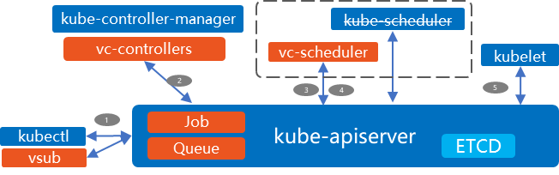
Volcano Project
Project Overview
The first open source cloud-native batch computing platform
Announced in June 2019, at KubeCon Shanghai.
Donated to CNCF in April 2020
Release every 3 months, Latest version is v1.4.0
1.9k star, 400+ fork, 120+ contributors
Volcano architecture
VC-Scheduler Configurable and scalable scheduling policies
VC-Controller
Queue for resource sharing and isolation
VC Job defined for high performance computing
Admission Webhook
Queue/Volcano job/PodGroup admission controller
CLI
Command line for Volcano

Slide 4





Volcano Key Features
AI
Big Data
HPC
Time-based multiplexing and time-based policy configuration
Queue-based dynamic resource sharing, including borrowing and borrowing thresholds
Queue-based scheduling configuration
Fair scheduling between queues and priority queues
Resource reclaiming and preemption between queues
1
Hybrid deployment of multiple types of jobs
……
2
Queue based job management
Job-level preemption and expulsion
Scheduling Based on Job Topology and IO
Remote Shuffle Service
Data oriented job scheduling
Resource reservation and backfilling
Job and application oriented fair/priority scheduling
Application orchestration-oriented resource scheduling, e.g. reservation
Job Scheduling
3
Multiple advanced scheduling policies
Node
Node
……
used
used

Slide 5
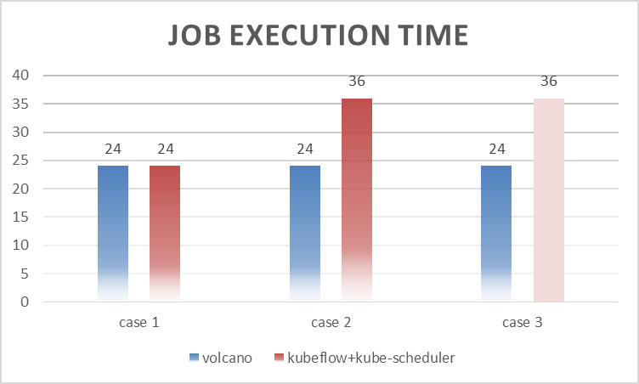
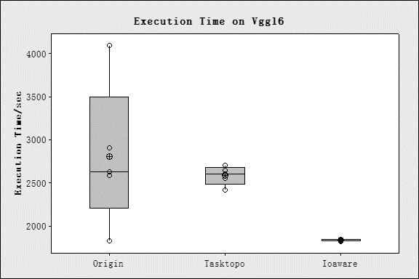
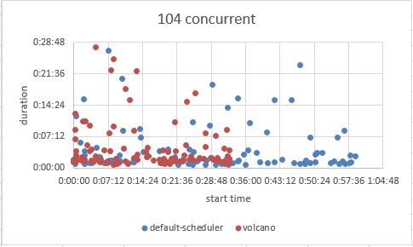
Performance
AI distributed training scenarios
Gang scheduling: 30% higher performance by eliminating endless waiting and deadlocks for parameter servers (ps) and workers in distributed training tasks.
Task-topology/ IO aware scheduling: 31% higher performance for I/O-intensive applications by reducing the transmission latency to the greatest extent.
Big data scenarios
minResource: 30%+ higher performance by preventing resource contention between the Spark driver and executor in high-concurrency scenarios and by properly planning the parallelism degree.
Distributed training scenario 1
Distributed training scenario 2
Big data TPC-DS performance test

Slide 6
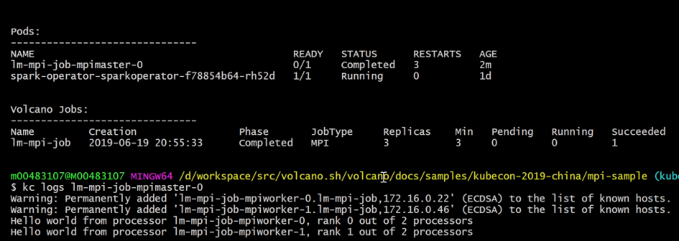
Running MPI with Volcano Job
apiVersion: batch.volcano.sh/v1alpha1 kind: Job metadata: name: lm-mpi-job labels: "volcano.sh/job-type": "MPI" spec: # minimum number of pods need to be started minAvailable: 4 schedulerName: volcano plugins: # job level ssh trust ssh: [] # define network relevant info for running,
# hosts, headless services etc. svc: [] # restart who job if any pod get evicted policies: - event: PodEvicted action: RestartJob tasks: - replicas: 1 name: mpimaster # Mark whole job completed when mpiexec completed
policies: - event: TaskCompleted action: CompleteJob
$ kubectl –f mpi_example.yaml
Kubernetes
mpirun
Small resource requests, e.g. 0.5 CPU
Gang scheduling
Job lifecycle
Resource Costs, e.g. spot instance
Job level ssh trust, no need to update key
worker_1
worker_2
CNI or host network, supports IB/RoCE
worker_3
Large resource requests, heterogeneous resource included (e.g. GPU)

Slide 7
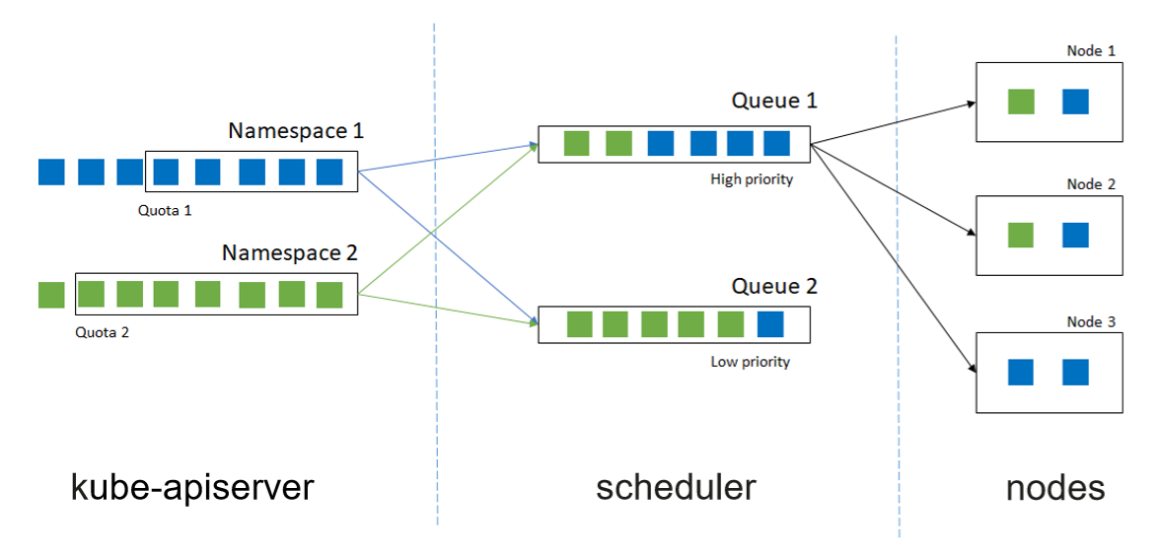
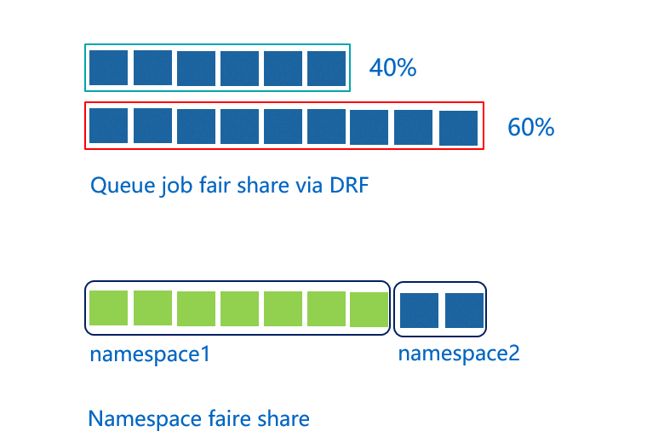
Resource Sharing
Queue capacity can be statically configured.
Multiple queues can dynamically share cluster resources based on the proportion. Fair-share scheduling at multiple levels is supported.
Idle queue resources can be lent to other queues. Resources can be used by different queues at different times.
Namespace fair-share

Slide 8
NUMA-Aware Scheduling Policy
Background and requirements:
Computing-intensive and performance-demanding jobs exclusively occupy CPU resources.
Standard NUMA architecture processor. The CPUs applied by pods are on the same NUMA node, which reduces communication loss.
The topology manager and CPU manager of Kubernetes work only on kubelet and do not participate in job scheduling. The scheduler is not aware of the node NUMA topology.
Key technologies:
The NUMA info component reports the node NUMA information.
Volcano provides the NUMA aware plug-in to collect node NUMA information and the pod topology policy for better pod scheduling.
Socket 0
Socket 1
Local Memory
NUM node 1
Local Memory
NUM node 0
0
1
0
1
2
3
2
3
Inter-socket connection

Slide 9


Hybrid Scheduling and Oversold Resources
The oversold part
unstable
request
Pain points:
Different services are deployed in different clusters. A single cluster can be a large-scale cluster.
Online services experience large fluctuation in traffic every day. A large number of resources are idle during off-peak hours, causing resource waste.
Some users are not sure about how many resources are required to run services and end up applying for too many resources.
The cluster resource allocation rate is high, but the resource usage is low. The average CPU usage could be less than 15%.
Key Technologies
qos-feature: EulerOS supports QoS.
kubelet: Support for the QoS model, resource report in real time, oversold resources calculation, and job eviction.
scheduler: Cluster scheduler. Support for the QoS model and diverse types of services with a unified resource model.
stable
used
Physical server
Scheduler
Volcano scheduling engine
K8s API Server
Node1
Node2
Transcoding and AI
Big data, AI, and web
OBS
Web
tfjob
SFS Turbo Cache
Spark
tfjob
Web
ENI
ENI
ENI
ENI
ENI

Slide 10


Use Case: AI platform at Xiaohongshu
recommend service
model
About Xiaohongshu
Top social media and e-commerce platform with over 100 million active users per month
Recommendation is one of core business. AI platform at Xiaohongshu consists of online and offline training system, which undertakes hundreds of thousands samples analysis and model training. The model generation has already be on the minute scale.
Challenge
Training cluster with thousands of nodes
Recommendation model with nearly 100 billion parameters
A single training task contains hundreds of PS and workers
Require best topology scheduling and performance
Solution
Adoption of binpack and task-topology scheduling policy
Adoption of gang-scheduling
Benefit
20% increase on AI training speed overall
20% increase on AI training throughput
Starvation prevention on big jobs
release
online
service
characteristic
cache
model release
model training
Flink training data generator
label
computing
training data
model training based on Volcano
Based on these pain points, we did some research and found Volcano, which can completely solve our pain points. Therefore, we also participated in the Kubernetes batch community and became a loyal user of volcano.
-- Yi Guo(Tech-Lead at Xiaohongshu)

Slide 11
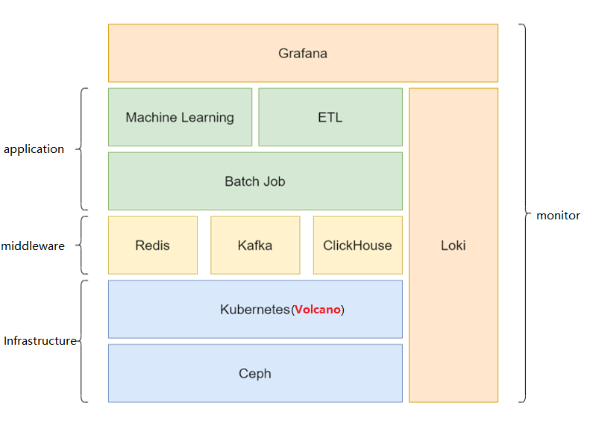
Use Case: Batch Computing Platform at Ruitian Investment
Background：
Top financial investment company in China
AI training and reasoning
Big data ETL & batch offline tasks
Scenarios：
Fair scheduling for resource sharing among multiple teams
gang-scheduling to avoid dead lock
support mixed scheduling for AI, Big data, batch tasks
Benefit：
Volcano for all business online
Queue and Fair scheduling policies satisfy all requirements
More than 300k pods scheduled per day in production
“Volcano is based on Kubernetes, and its robust job scheduling and control policies meet all of our requirements.
Its simple architecture was a major reason we decided to migrate our scheduling platform from Yarn to Kubernetes.”
-- Yunzhi Cheng, Director of Engineering at Ruitian Investment
Ref: https://www.cncf.io/blog/2021/03/26/how-ruitian-used-volcano-to-run-large-scale-offline-hpc-jobs/

Slide 12














Use Case: Gene computing service for BGI
Easy to use：
Provide process management and scheduling
Seamless migration from SGE cluster
Provide Cromwell engine、support WDL grammar
Reduce Cost：
Cluster utilization up to 90%
On-demand billing
Flexible CPU/Mem ratio support
No maintenance：
Auto scaling
Remove environmental dependence
Workflow/process is replicable
Fine-grained monitor
Genome Sequencing company
Gene cloud
Cancer detection
Technical service
Virus analysis
…..
SGE migration
Cromwell
Job dependency
Real-time Analysis
GCS
Gene Container
ARTICnetwor
Scheduler
Serverless
Engine
Kubernetes
CPU
GPU
KunPeng
Storage
Cloud storage EVS
Object storage OBS
File Storage SFS
High speed EFS
3大优势

Slide 13




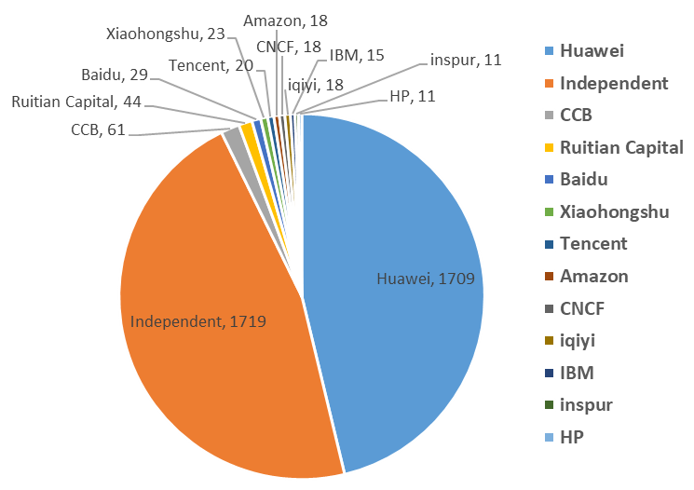
















Adoption and Contribution
Part of Adoption in Production
Volcano code diversity in recent 1-year
Data from https://volcano.devstats.cncf.io

Slide 14

Community Releases Journey
Volcano: a kubernetes native batch system
v0.1:
IndexedJob
Multiple pod templates
Pod/Job error handling
Queue/Job command line
Delayed pod creation
Job plug-ins
v0.2:
Job priority
Queue capacity
Fair-share of NS cross queues
Binpack algorithm
Multiple events in job lifecycle policy
v0.3:
Added maxRetry in job controller
Bug fix of scheduler, e.g. resource and callback
Dynamic load scheduler configuration
Supported network policy
Command line enhancements
v1.0:
GPU sharing
Preempt and reclaim upgraded to Beta
Job dynamic scale up and down
Integrated with flink operator
DAG job based on Argo
v1.3:
Support minAvailable at task level
Support task-topology
Support minSussess for Job
Create new repository volcano.sh/apis
…...
v1.4:
Support multi-scheduler
Support CPU NUMA-Aware scheduling
Support proportion of resource for GPU node
…...
…
May 2019
September 2019
January 2020
July 2020
May 2021
September 2021

Slide 16
Resources
Website: https://volcano.sh
Github: https://github.com/volcano-sh
Slack channel: https://volcano-sh.slack.com
Weekly community meeting: https://zoom.us/j/91804791393 | Subscribe Meeting Calendar
Documentation: https://volcano.sh/en/docs/
Join our community and give us feedback!

